Slide 1

QVA149 reduces the risk of moderate-to-severe exacerbations compared with open-label tiotropium in patients with severe COPD: The SPARK study
Abstract No. 850294
Poster No. P898
Jadwiga A Wedzicha¹, Marc Decramer², Petter Olsson³, Hungta Chen⁴, Robert Fogel⁴, Donald Banerji⁴
¹Airway Disease Section, National Heart and Lung Institute, Imperial College London, London, UK; ²Respiratory Division, University of Leuven, Leuven, Belgium; ³Novartis Pharma AG, Basel, Switzerland; ⁴Novartis Pharmaceuticals Corporation, East Hanover, NJ, USA
Poster presented at ERS Annual Congress, Munich, Germany, 6-10 September 2014
Click here to download a high resolution version of this poster
Scan to download a reprint of this poster
QVA149: fixed combination of indacaterol and glycopyrronium

Slide 2
Disclaimer
Dieser Foliensatz basiert ausschließlich auf öffentlich zugängliche Informationen.
Dieser Foliensatz ist ausschließlich für den persönlichen Gebrauch zu Schulungszwecken gedacht und ist nicht für die allgemeine Verbreitung bestimmt.
Die Informationen wurden nach bestem Wissen vollständig und aktuell zusammengestellt.
Novartis Pharma GmbH übernimmt keinerlei Gewähr für die Vollständigkeit oder Aktualität der in diesem Dokument bereitgestellten Information.
Novartis Pharma GmbH ist nicht für die spätere Verwendung über den vorgesehenen Zweck hinaus bzw. für Änderungen des Vortrages durch Sie oder Dritte verantwortlich.
Stand der Information: Oktober 2015

Slide 3
Methods Study design
SPARK was a multicentre, randomised, parallel-group, active-controlled (open-label [OL] tiotropium) study consisting of a 64-week double-blind treatment period and an additional variable double-blind period (up to Week 76). The study was extended to 76 weeks while it was on-going to increase the number of exacerbation events to ensure the study achieved the exacerbation rate pre-specified for analysis
Eligible patients were randomised (1:1:1) to receive IND/GLY 110/50 g or glycopyrronium 50 g (both via the Breezhaler® device), or OL tiotropium 18 g (via the HandiHaler® device) at the end of 14-day run-in period
Randomisation was stratified by current/ex-smoker status and inhaled corticosteroid (ICS) use
Patients completed an electronic diary in the morning, before taking study drug, and in the evening
IND/GLY: Fixkombination aus Indacaterol und Glycopyrronium

Slide 4
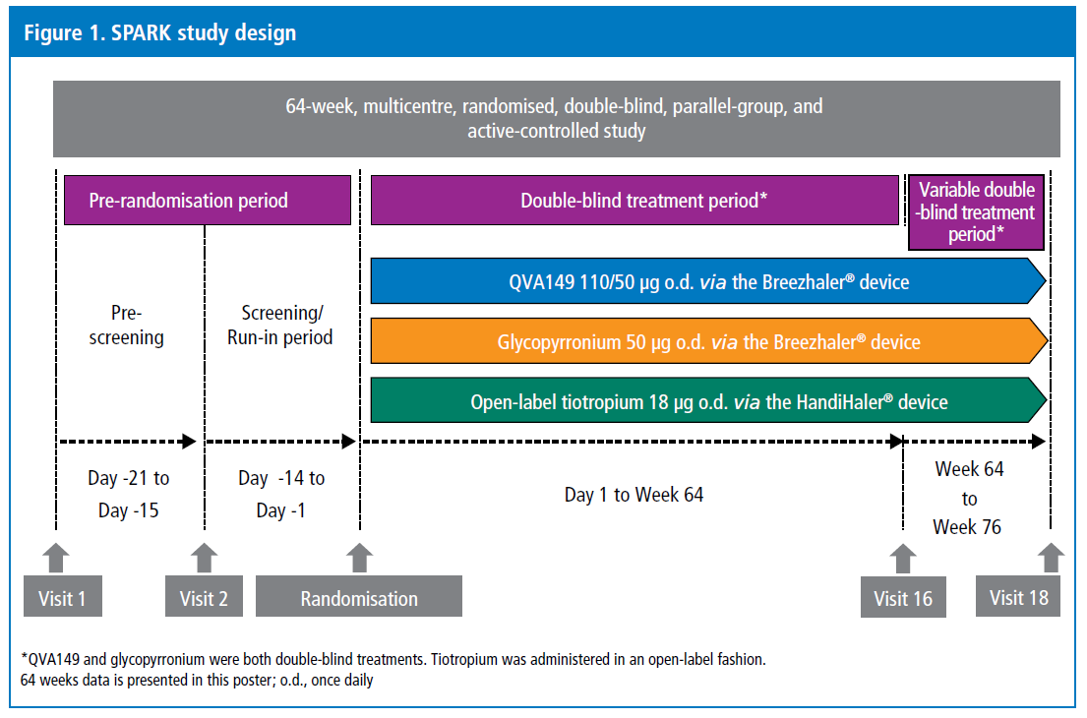
Methods Study design
QVA149: fixed combination of indacaterol and glycopyrronium

Slide 5
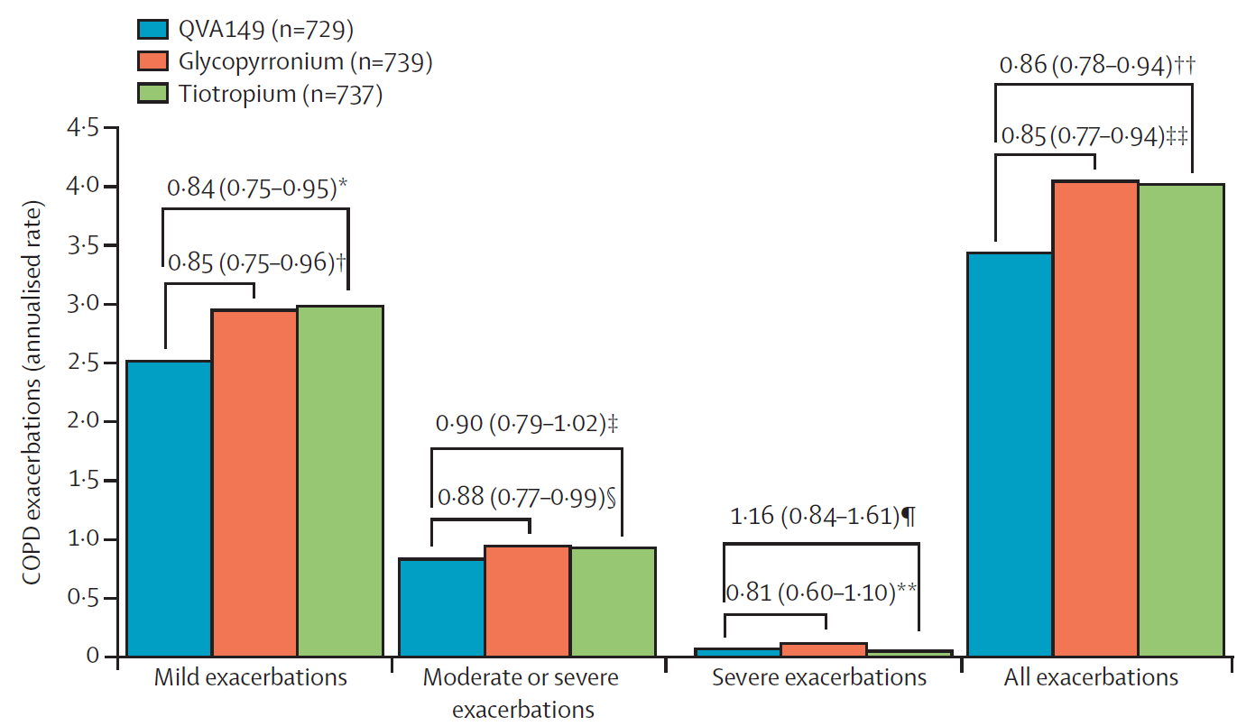
Exazerbationen in der SPARK Studie
QVA149: fixed combination of indacaterol and glycopyrronium
Wedzicha et al. Lancet Respir Med. 2013 May;1(3):199-209

Slide 6
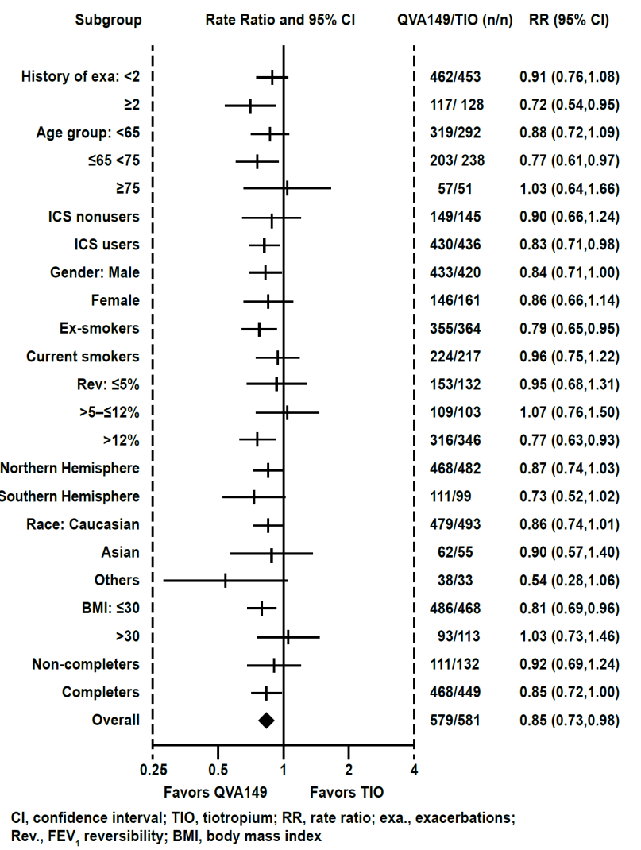
Abstract No. 850294
Figure: Rate ratio of moderate to severe exacerbations in patients with QVA149 versus TIO
Introduction
QVA149 is an approved once-daily (o.d.) dual bronchodilator combination of the LABA, indacaterol, and the LAMA, glycopyrronium (GLY), for the maintenance treatment of patients (pts) with symptomatic COPD. Here we present the results of a post-hoc analysis conducted to evaluate the rate ratio (RR) of exacerbations in pts with severe COPD in the SPARK study¹.
Methods
This 64 week, multicentre, double-blind, parallel-group, active controlled (open-label TIO and GLY) study randomised pts with severe-to-very severe COPD and a history of ≥1 exacerbation in the previous year to receive o.d. QVA149 110/50μg, GLY 50μg or TIO 18μg.
Results
Of the 2224 pts randomised, 1744 had severe COPD (QVA149=579; GLY=584; TIO=581). QVA149 reduced the risk of moderate-to-severe exacerbations vs. GLY by 11% (RR 0.89; 95% CI 0.77, 1.04) and TIO by 15% (RR 0.85; 95% CI 0.73, 0.98) in pts with severe COPD. In a majority of subgroups QVA149, compared with TIO, reduced the risk of moderate-to-severe exacerbations (Figure). A similar reduction in risk of moderate-to-severe exacerbations was also seen with QVA149 compared with GLY in most of the subgroups.
Conclusion
Risk of moderate-to-severe exacerbation was reduced in severe patients with COPO who were treated with QVA149 compared with GLY and TIO.
QVA149: fixed combination of indacaterol and glycopyrronium
¹Wedzicha et al. 2013
Notes:
References:
1. Wedzicha JA, Decramer M, Ficker JH, Niewoehner DE, Sandström T, Taylor AF, D'Andrea P, Arrasate C, Chen H, Banerji D. Analysis of chronic obstructive pulmonary disease exacerbations with the dual bronchodilator QVA149 compared with glycopyrronium and tiotropium (SPARK): a randomised, double-blind, parallel-group study. Lancet Respir Med, 2013.1(3);199-209

Slide 7
Methods Patients
Men and women aged ≥40 years with severe or very severe COPD (stage III or IV according to GOLD 2008), and a smoking history of ≥10 pack-years
Post-bronchodilator forced expiratory volume in 1 second (FEV₁) <50% of the predicted normal value, post bronchodilator FEV₁/forced vital capacity (FVC) <0.7, and ≥1 COPD exacerbation in the previous 12 months requiring treatment with systemic corticosteroids and/or antibiotics
In this subgroup analysis, patients with severe COPD (GOLD stage III, post-bronchodilator FEV₁ ≥30%, <50% predicted and FEV₁/FVC <0.70) were included
Key exclusion criteria included a history of long QT syndrome, a prolonged QTc interval measured at Visit 2 (>450 ms for males and females), or a clinically significant abnormality on the screening or baseline electrocardiogram that could potentially place patients at risk if enrolled into the study

Slide 8
Methods Patients characteristics
Of the total 2224 patients randomised in the SPARK study, 1744 patients had severe COPD and received QVA149 (n=579), glycopyrronium (n=584) and OL tiotropium TIO (n=581), respectively
Demographics and baseline characteristics of patients with severe COPD were similar across the treatment groups (Table 1)

Slide 9
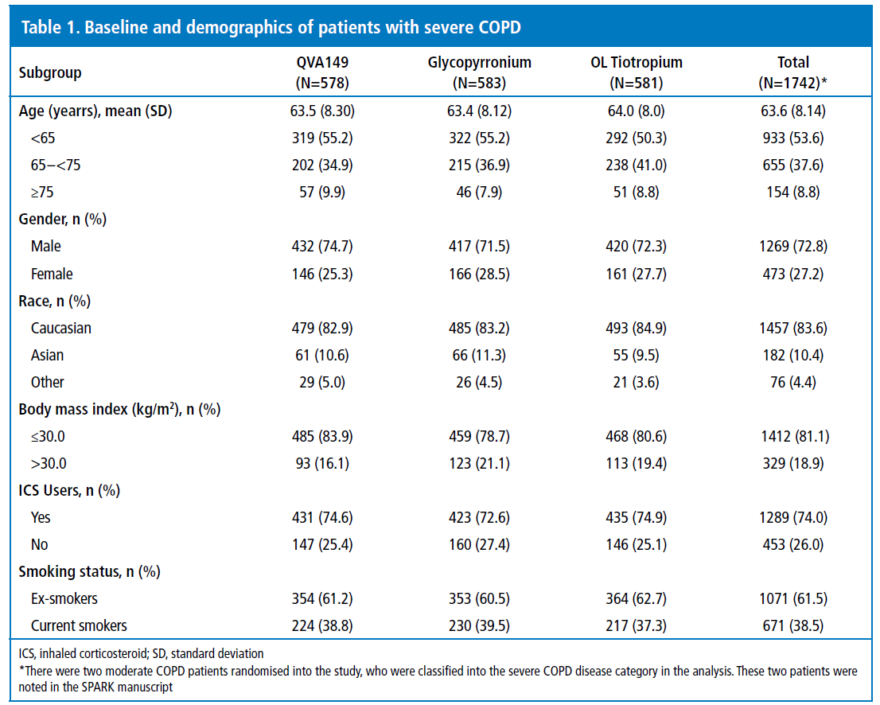
Methods Patients characteristics
QVA149: fixed combination of indacaterol and glycopyrronium

Slide 10
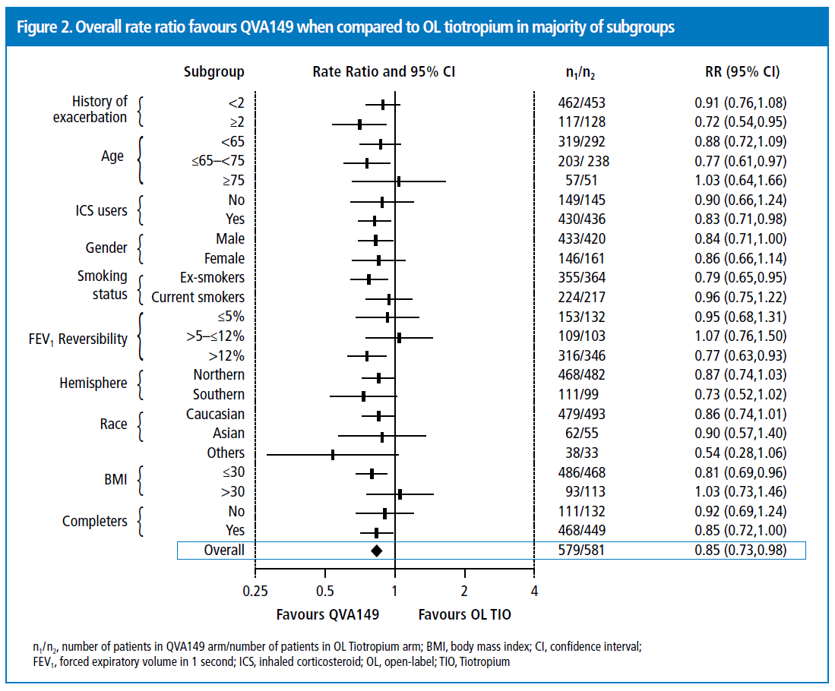
Results Efficacy – reduction of exacerbations vs OL tiotropium
IND/GLY significantly reduced the risk of moderate-to-severe exacerbations versus OL tiotropium – rate ratio = 0.85 (0.73 – 0.98), representing a 15% reduction in the rate of exacerbation in this population (Figure 2)
QVA149: fixed combination of indacaterol and glycopyrronium

Slide 11
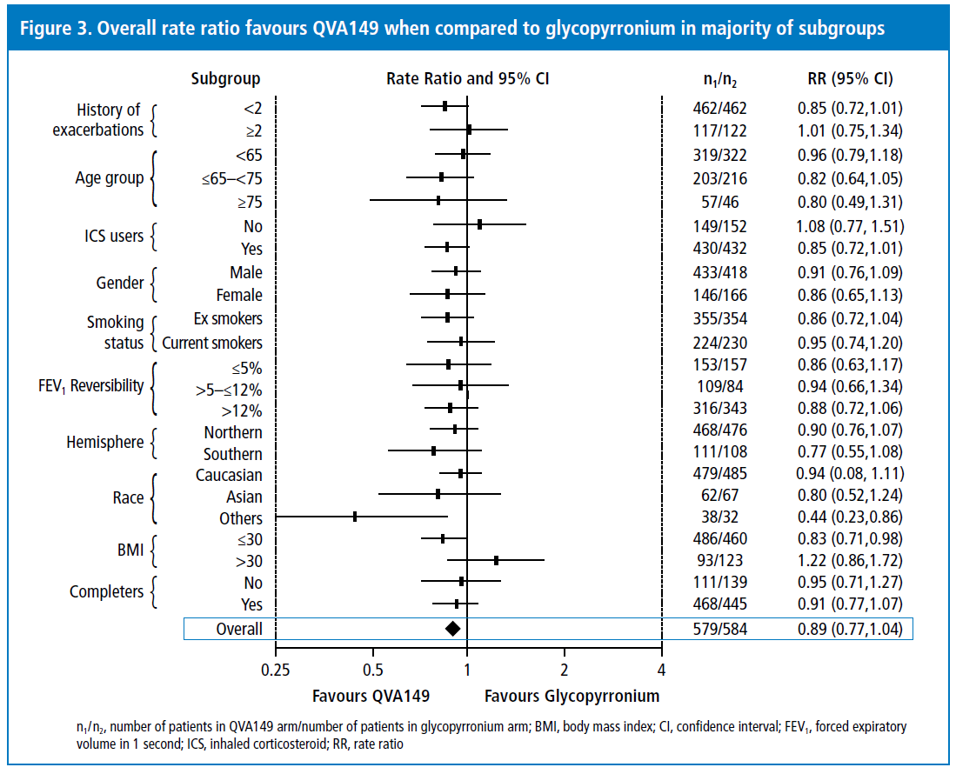
Results Efficacy – reduction of exacerbations vs glycopyrronium
IND/GLY numerically reduced the risk of moderate-to-severe exacerbations versus glycopyrronium – rate ratio = 0.89 (0.77 – 1.04), representing a 11% reduction in the rate of exacerbation in this population (Figure 3)
QVA149: fixed combination of indacaterol and glycopyrronium
Notes:
References:
1. Wedzicha JA, Decramer M, Olsson P, Chen H, Fogel R, Banerji D. QVA149 reduces the risk of moderate-to-severe exacerbations compared with open-label tiotropium in patients with severe COPD: The SPARK study. Presented as a poster (P898) at European Respiratory Society Annual Congress (ERS 2014), Munich, Germany, 6-10 September 2014.

Slide 12



DANKE

Slide 13
Ein Service von Novartis Respiratory
Kontakt:
Dr. Ewald Gingl, Medical Advisor,
ewald.gingl@novartis.com
Dr. Marcel Dautzenberg, Medical Scientific Liaison,
marcel.dautzenberg@novartis.com
Stand der Information: Oktober 2015, AT1511403179

